Slide 1
Progress review
23 July 2021

Slide 2
progress
refining the data | Current approach:
each ensemble member for every initial date has 1 netcdf file
filter data required for interested location
combine 1 month worth fcsts into a pandas dataframe
resample the hourly/3 hourly forecast to daily by taking the mean
Started working on bias correction
using the DMB approach
Trialled with small data:
2 ens. member
5 initial forecast days

Slide 3
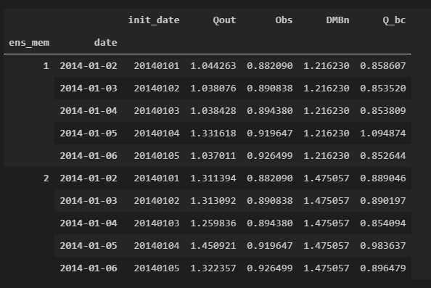
bias correcting day 2 forecasts over 5 days
ens_mem: the ensemble number
date: when the forecast is valid for
init_date: the initial date of the forecast
Qout: the raw streamflow output
Obs: the observed value based on the ERA5
DMBn: the DMB ratio taken across 5 days
Q_bc: bias corrected output

Slide 4
other work
Set up version control on Github
Future work:
Possibly switch to xarray
setup visualisation
investigate another method (leftover)
calculate N-S coefficient
setup energy calculation

Slide 6
implemented bias correction
current mini-dataset:
5 ensembles
5 days across 2014 Jan and 2015 Jan
calculate DMB parameter using 2014 data for day 2 forecasts
implement it to 2015 day 2 forecasts
1 year apart is a big gap?
need to dig through some lit again.
further: extend it to longer time for other forecast days
other: retrieved streamflow ground based observations for a site

